Slide 1
MINIPROJECT 1
Web Presentation

Slide 2

AirGlobe
Project name

Slide 3
Purpose of Project
Global warming is a pressing issue that is affecting the entire planet. It is a gradual increase in the Earth’s average surface temperature due to human activities such as the burning of fossil fuels, deforestation, and industrial processes. The effects of global warming are numerous, including rising sea levels, more frequent and severe natural disasters, heat waves, and extreme weather patterns. These effects have significant impacts on human health, agriculture, and wildlife, leading to biodiversity loss and ecological imbalances. The time to act on global warming is now, and we must all work together to protect our planet and secure a sustainable future for generations to come. Through this website, we will make a big difference by informing the world about the ongoing environmental problems that each country face through providing the latest and hottest news we can gather. Moreover, this site provides factual information and evidence to address any inquiries you may have about global warming.

Slide 4
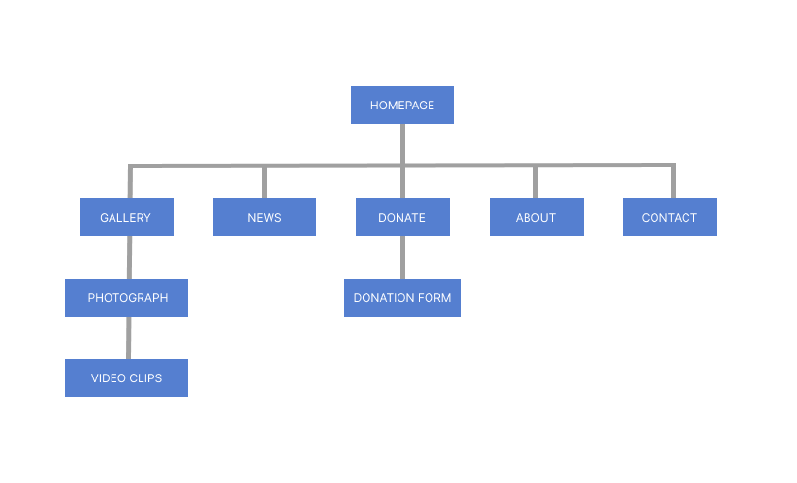
Sitemap
For AirGlobe

Slide 5
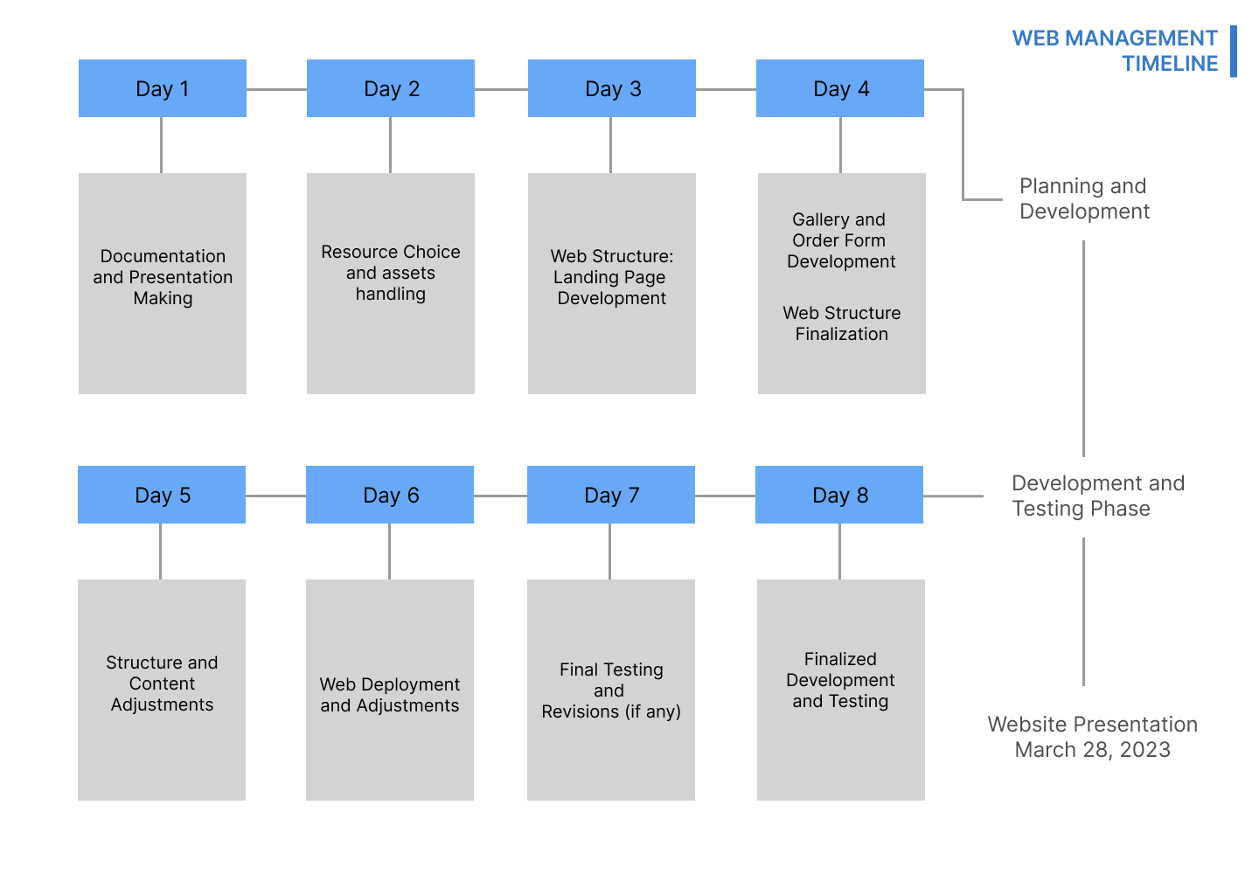
TIMELINE
MARCH
20 –28

Slide 6

Wireframe and Mood
Mobile and Desktop View

Slide 7


Landing Page
Desktop View

Slide 8

Donation Page

Slide 9

Message Us Page

Slide 10

Photos

Slide 11
Sign Up Page

Slide 12

Videos

Slide 13

Who we are

Slide 14
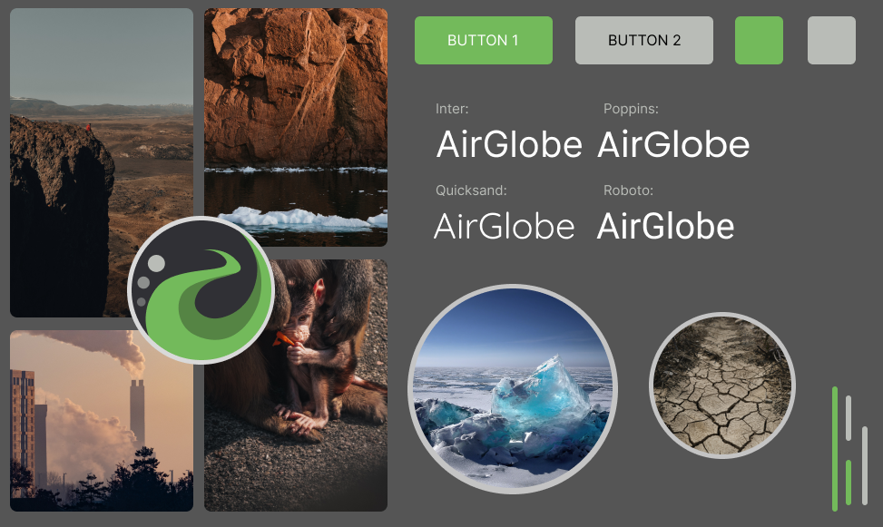
MOOD BOARD
WEBSITE
THEME

